Slide 1

Graduate Training
www.pwc.co.uk
Financial Crime
October 2016
Notes:
Front cover slide with activated logo

Slide 2
Agenda
Schedule | Topic | Activity | Speaker | Time (min)
9:30 – 10:00 | Introduction | Team/Grads introduction & ARCA Financial Crime Practice | Natasha Mushfique | 10
 |  | Introduction to Financial Crime | Natasha Mushfique | 20
10:00 - 11:00 | Customer Onboarding | Overview of KYC procedures | Natasha Mushfique | 10
 |  | Sanctions | Mayur Dashani | 15
 |  | Client Risk Assessment | Nick Kawecki | 15
 |  | Activity + Questions | Mayur/ Nick | 20
Coffee Break |  |  |  | 15
11:15 – 12:30 | Transaction Monitoring | Introduction to Transaction Monitoring | Natasha Mushfique | 10
 |  | Scenario Selection | Robin Bhurton | 15
 |  | Customer Segmentation | Jim Prevot | 15
 |  | Threshold Tuning | Sonali Warriar | 15
 |  | Activity + Questions | Jim/ Robin/ Sonali | 20
Lunch |  |  |  | 60
1:30 - 2:05 | Trade-Based Money Laundering | Trade-Based Money Laundering | Jim Prevot + Nick Kawecki | 15
 |  | Activity + Questions |  | 20
2:05 - 2:50 | Fraud, ABC & Market Abuse | Fraud (Identity & Product) | Jeremy Davey | 15
 |  | Anti-Bribery & Corruption |  | 15
 |  | Market Abuse |  | 15
Coffee Break |  |  |  | 10
3:05 - 3:35 | Future of Banking & FinCrime Technologies | New Payment Methods | Mayur Dashani | 15
 |  | New vendors in the space | Sonali Warriar | 15
3:35 - 4:50 | Final Activity | Group creation | Jim/ Robin/ Sonali/ Mayur/ Nick | 15
 |  | Activity |  | 60
4:50 - 5:00 | Summary & Closing | Presentation | TBC | 10
5:00 onward | Closing drinks and nibbles | Eating and drinking :) |  | …

Slide 3
Introduction
Speakers:
Scott Samme
Jeremy Davey
Natasha Mushfique

Slide 4

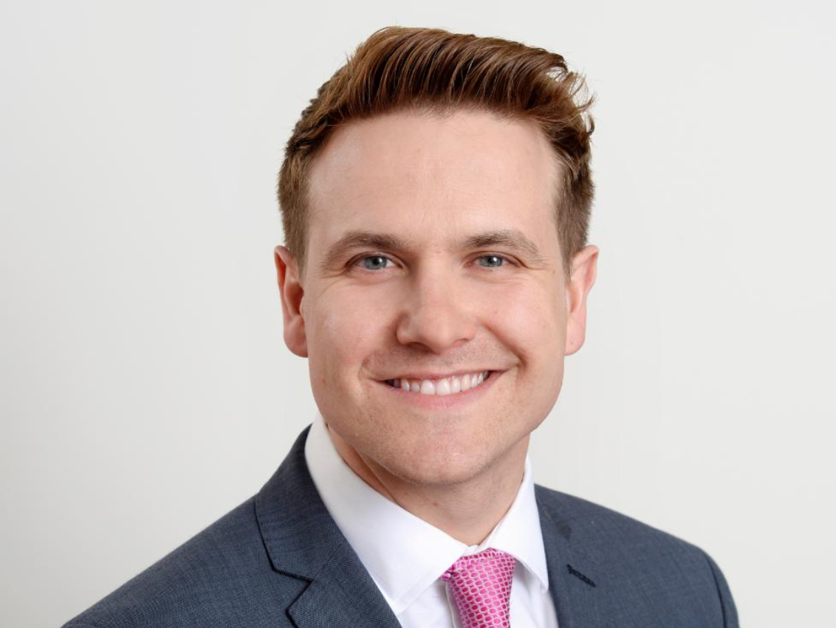
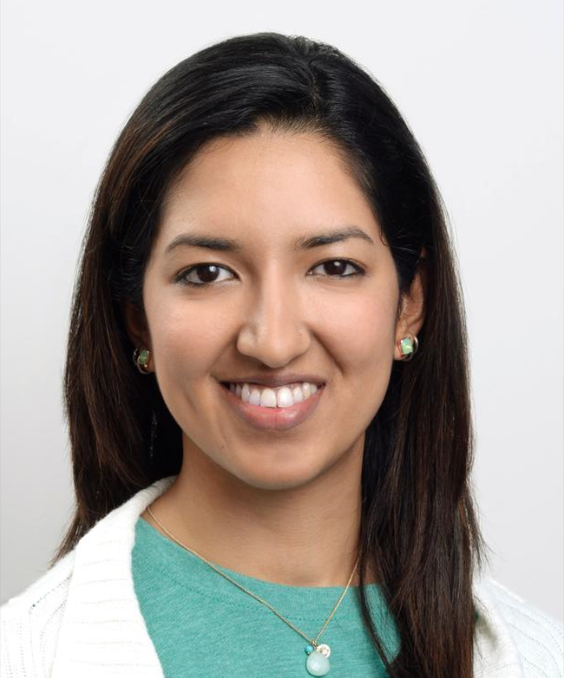

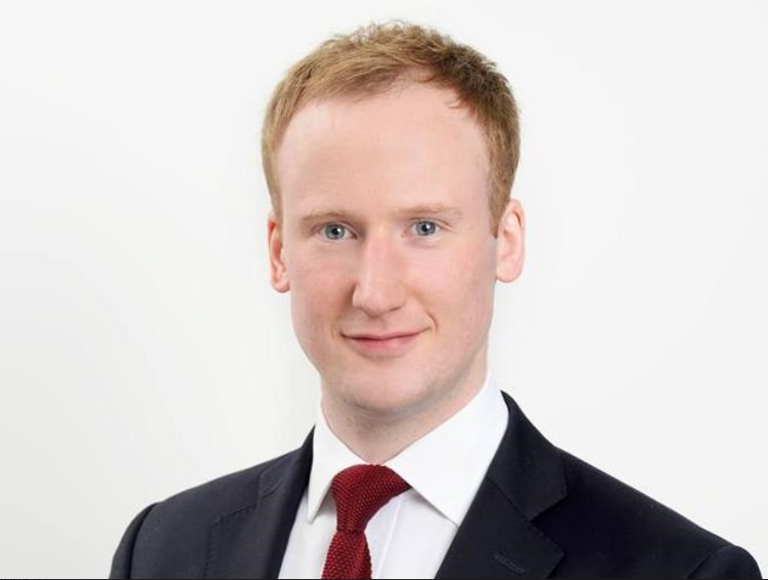

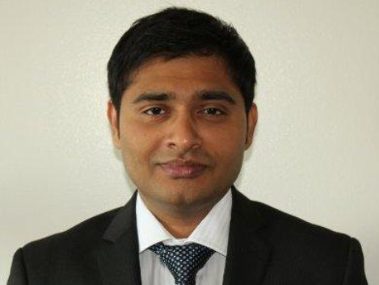

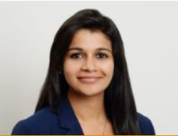
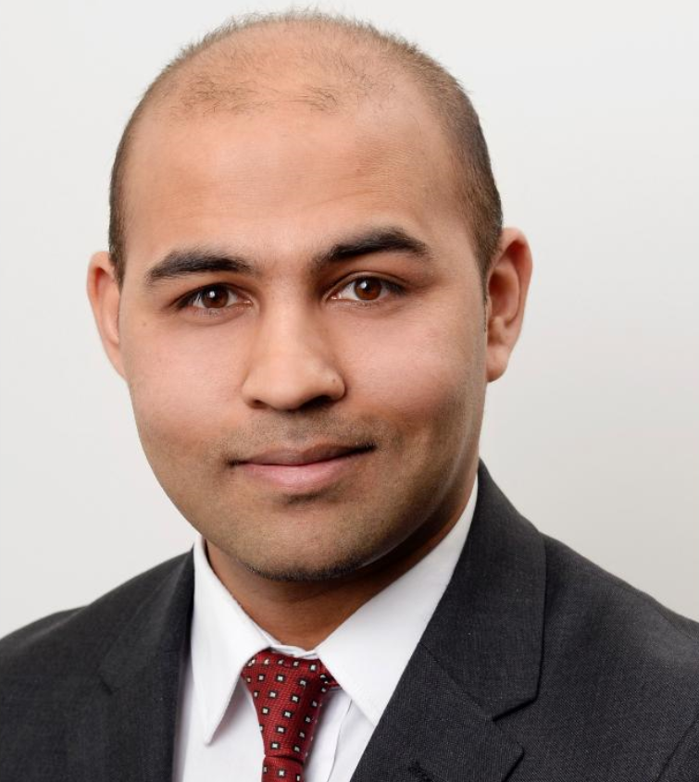
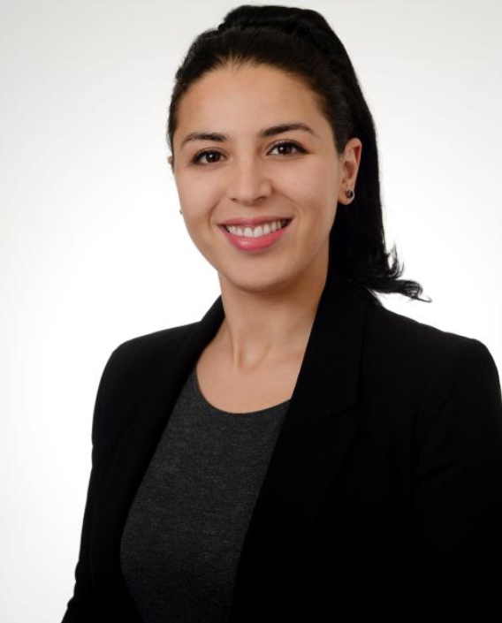



Team Introduction
Scott Samme Director
Jeremy Davey
Senior Manager
Natasha Mushfique
Manager
Gokhan Aksu
Manager
Nick Kawecki
Manager
Sebastian
Mathalikunnel
Senior Associate
Mayur Dashani
Senior Associate
Jim Prevot
Senior Associate
Sonali Warriar
Senior Associate
Robin Bhurton
Senior Associate
Fahrida
Benzerrouk
Senior Associate
Jess Brohier
Associate
David Miller
Associate
Hamish Solanki
Associate

Slide 5
What is Financial Crime?
Financial crime is any crime involving money and/or financial markets.
More formally, the Financial Services and Markets Act 2000 defines financial crime “to include any offence involving (a) fraud or dishonesty; (b) misconduct in, or misuse of information relating to, a financial market; or (c) handling the proceeds of crime.”
The use of the term ‘to include’ means financial crime can be interpreted widely to include, for example, corruption or funding terrorism.
There is no single universal definition of financial crime, and the term is sometimes used interchangeably with:
1) White-collar crime (i.e. crime committed by a person of respectability and high social status, in the course of his occupation)
2) Corporate crime (i.e. crime committed by a corporation or individuals associated with a corporation)
3) Occupational crime (i.e. crime committed through opportunity that arises in the course of employment)
4) Economic crime (i.e. crime related to financial fraud, money laundering and corruption).
But the common thread that runs through anything termed financial crime is that it involves ILLICIT FINANCIAL FLOWS.
Notes:
So of course, we cannot start the module without talking about the definition of financial crime first.
There is no single universal definition of financial crime, and the term is sometimes used interchangeably with:
1) White-collar crime (i.e. crime committed by a person of respectability and high social status, in the course of his occupation)
2) Corporate crime (i.e. crime committed by a corporation or individuals associated with a corporation)
3) Occupational crime (i.e. crime committed through opportunity that arises in the course of employment)
4) Economic crime (i.e. crime related to financial fraud, money laundering and corruption).
But the common thread that runs through anything termed financial crime is that it involves ILLICIT FINANCIAL FLOWS.

Slide 6











Financial crime & compliance What are the different competencies that we cover within this area
Anti-money laundering (AML)
Joining the dots between the different types of financial crime (for example fraud is a predicate offense to money laundering), cross border relationships and external sources of intelligence to report and action on.
Sanctions
Know Your Customer
Transaction monitoring
Anti-bribery & corruption
Fraud
Trade surveillance
Comms surveillance
Conduct & Culture
Financial organisations are being encouraged to take a risk based approach managing their financial crime risk, this has resulted in a need for organisations to define their risk appetite for the different types of financial crime and then carry a review of their inherent and residual risk to identify their current position and actions that need to be completed.
Economic sanctions are domestic penalties applied unilaterally by one on another country or entity. Prohibit firms from providing funds and other economic resources to individuals and entities.
KYC is the process of a business verifying the identity of its clients.
Transaction monitoring focuses on identification of suspicious patterns of transactions.
Bribery is the offering or acceptance of an undue advantage in exchange for the improper performance of a function or activity.
Corruption is an abuse of a position of trust in order to gain an undue advantage.
Due to the importance of credit and market risk models to a financial organisation these have been long subject to regulatory oversight with the need to have in place appropriate management and validation procedures. Financial crime models are now being subject to similar levels of scrutiny, with regulators publish guidance on the subject, “Supervisory Guidance on Model Risk Management” OCC 2011-12.
Process of concealing or disguising the existence, source, movement, destination, or use of illicitly-derived property or funds to make them appear legitimate.
In law, fraud is deliberate deception to secure unfair or unlawful gain.
Monitoring of the markets to identify and investigate unusual activity which could be as a result of rogue trading, market manipulation, insider trading, etc.
Surveillance of communications to identify collusive and other behaviour within and between organisations to commit crime.
Promotion and monitoring of the right conduct and culture within financial organisations as a result of numerous events, such as PPU mis-selling.
Intelligence
(FCIU)
Risk assessment
Model
management

Slide 7
Money Laundering What is it and how do we combat it?
Money Laundering Cycle
Money launderers are often sophisticated criminals, who quickly change their modus operandi to cope with stricter anti-money laundering laws/regulations.
Money laundering is not just about cash; neither is it a problem isolated to the banking industry. Money launderers have greatly diversified their operations across financial services sectors.
Anti-Money Laundering (AML) is the term mainly used in the financial and legal industries to describe the legal controls that require financial institutions and other regulated entities to prevent, detect and report money laundering activities.
Anti-money laundering guidelines came into prominence globally as a result of the formation of the Financial Action Task Force (FATF) and the promulgation of an international framework of anti-money laundering standards.
1. Illicit Activity
Corruption and bribery , fraud, drug and human trafficking, terrorism and other serious crimes.
4. Integration
Laundered proceeds are distributed back to the criminal.
Creates appearance of legitimate wealth.
2. Placement
Initial introduction of criminal proceeds into the financial system
Most vulnerable stage of money laundering
3. Layering
Involves distancing the money from its criminal source.
Movements of money into different accounts/ countries
Increasingly difficult to detect
Notes:
Money laundering harms innocent individuals but can also impose serious costs on national economies.
Anti-Money Laundering (AML) has become the most common category that banks are being penalized for as US/UK regulators step up enforcement.
The UN estimates that the amount of money laundered annually is equivalent to 2-5% of global GDP.
In fact, if money laundering were an economy, it would be the fifth largest in the world (Germany’s GDP is 3.2 tr and cost of money laundering was 1.6 tr). Since 2007, banks have paid over $21 billion in cumulative AML fines.
There are three key points that I would like you to take away from this slide:
Money laundering is basically about concealing the source of funds from illegal activity and it is constantly evolving
It is a problem that affects any industry using money or financial markets
AML guidelines were first established by the FATF
Understand the money laundering cycle

Slide 8
Financial Crime Regulatory Framework
INTERNATIONAL ORGANISATIONS
UN, IMF, World Bank, OECD, WTO
FATF, Egmont Group, Wolfsberg Group, Transparency International
REGIONAL
ORGANISATIONS
EU, Regional bodies such as ASEAN, GCC, etc.
DOMESTIC ORGANISATIONS
Legislation and Regulation
FIU’s, Regulators, Competent Authorities
DOMESTIC GUIDANCE
(sector specific)
FI’s, Non Bank FI’s, High Value Goods Dealers, Gambling and Gaming providers

Slide 9
Reporting Suspicious Activity
Currency Transaction Report (CTR)
A currency transaction report (CTR) is a report that U.S. financial institutions are required to file with FinCEN for each deposit, withdrawal, exchange of currency, or other payment or transfer, by, through, or to the financial institution which involves a transaction in currency of more than $10,000. It must be filed within 25 days of the transaction.
In the UK, there is no transaction reporting of a similar nature.
Suspicious Activity Report (SAR)
In the US, transactions of USD 5,000 or more involving potential money laundering and/or Bank Secrecy Act violations if the Financial Institution knows, suspects, or has reason to suspect that:
The transaction involves funds from illegal activities and is designed to hide or disguise the true nature of the funds
The transaction is designed to avoid reporting
The transaction has no apparent business purpose and cannot be adequately explained by investigation
In the UK, there is no specific threshold or monetary limit applicable for filing a SAR.

Slide 10
What is currently driving the industry? Prevention and detection of financial crime is rapidly evolving to be one of the biggest challenges to financial institutions, the impact of which extends well beyond monetary losses to reputation and brand, employee morale, business relations, as well as regulatory censure.
Regulation
Within the financial services industry the volume of regulation that needs to be complied with, especially in relation to financial crime, has increased significantly in the last 5 years. With Regulators and Law Enforcement equally focused on ensuring both their standards and also those of the financial institutions they regulate are set at the highest level.
This affects financial institutions of all sizes and shape, with increasing pressure
on the relationships between institutions, due to the risk flowing from
one institution to another.
Fines and losses
The value and volume of fines due to inadequate procedures, poor data management and un-tuned technology solutions that has been meted out to financial institutions has increased substantially over the last 5 years, especially in relation to Financial Crime. In addition losses due to poor controls continue to escalate as well, it is estimated that fraud losses in UK private sector are £15.9bn per annum (NFA, 2013).
Bank | Fine in $m | Reason | Year
BNP Paribas |  | Anti-sanctions | 2014
Various* |  | FOREX rigging | 2015
Deutsche bank |  | LIBOR manipulation | 2015
HSBC |  | Money laundering lapses | 2012
UBS |  | LIBOR manipulation | 2014
Commerzbank |  | Anti-sanctions | 2015
UBS |  | Tax evasion | 2009
 |  |  |  |  |  |  |  |  | Regulation
2007 | 2008 | 2009 | 2010 | 2011 | 2012 | 2013 | 2014 | 2015
9,000
6,300
2,500
1,920
1,530
1,450
780
Response
Financial institutions are currently undergoing change programmes to address regulation and / or as a result of fines and losses across all areas of there business. These programmes are at different stages and of varying type, from current state assessment to identify risks to large scale transformational change.
Assistance is required in many different forms to make these programmes a success and to embed change into the institution.
Standards, policies & procedures
Systems and controls
Financial Crime Compliance
Forensic investigation
File remediation
Data

Slide 11
A customer’s journey through FinCrime
1
2
3
4
You apply for a bank product
You make a payment or transaction
You continue to use the account periodically
You complete a year with the bank
WHAT YOUR BANK IS DOING IN THE BACKGROUND
Customer Onboarding
Client Identification & Verification (ID&V)
Client Due Diligence: Client profile, UBOs, controllers, relationships, SoF/SoW, PEPs, negative news etc.
Customer screening for sanctions
Client Risk Assessment: risk factors and ratings
Payment Screening & Filtering
Sanctions screening on sender and receiver, names and address details.
Ability to block payments or suspend account.
Occurring in real-time.
Transaction Monitoring
Monitoring of completed transactions looking for patterns or anomalies that identify the potential risks (“red flags”) of money laundering.
May result in investigations which lead to NCTs, SARs, etc.
Ongoing Reviews
Higher risk clients will go through a periodic review and more robust level of due diligence.
Other reviews may be triggered by events.
May lead to investigations and potentially customer exit if deemed appropriate.

Slide 12
Customer Onboarding
Speakers:
KYC Procedures – Natasha Mushfique
Client Risk Assessment – Nick Kawecki
Sanctions Screening – Mayur Dashani

Slide 13
KYC Procedures
Natasha Mushfique

Slide 14
Customer Identification Programme (CIP) (i.e. Know Your Customer or ‘KYC’)
A Customer Identification Program (CIP) is a US requirement arising from the USA Patriot Act.
It requires financial institutions need to verify the identity of individuals wishing to conduct financial transactions with them.
More generally known as Know Your Customer (KYC).
First line of defence in AML programme.
Financial institutions should consider:
The types of accounts offered
The methods of opening accounts.
The types of identifying information available
The institution's size, location, and customer base

Slide 15
Components of CIP: Customer Due Diligence (CDD) and Enhanced Due Diligence (EDD)
Risk based approach to monitoring AML risks.
CIP focuses on the identification and verification of who is opening the account (minimum requirement: name, address, DOB and identification number).
CDD is knowing the background on the customer, knowing the planned and expected activity in the account plus:
Source of funds
Products and services desired
Types and volumes of transactions
EDD is Enhanced Due Diligence for higher risk customers (additional research, continuous monitoring )

Slide 16
More on Politically Exposed Person (PEP)
Definition: A current or former senior foreign political figure, their immediate family and close associates.
‘Senior foreign political figure’ is a senior official in the executive, legislative, administrative, military or judicial branches of foreign government
Includes any corporation, business or other entity formed by or for the benefit of a senior political figure
PEPs are generally considered ‘high risk’ customers
PEPs have used banks as conduits for their illegal activities including corruption, bribery and money laundering
Banks that conduct business with dishonest PEPS face substantial risks
Banks must ascertain status of PEP accounts
Conduct risk based scrutiny of such accounts

Slide 17
The “True Risk of a PEP” Why Ultimate Beneficial Ownership (UBOs) are critical
Government of ABC Country
State owned oil company – PEP is chairman of the board and also the deputy prime minster
Personal Investment Vehicle - Panama, with Liechtenstein Foundation holding beneficial interest via bearer shares.
Success fee paid back to MR.A’s personal investment vehicle (£7m).
PEP old school friend Mr A, a lawyer within ABC country requests him to find an investment bank to assist with a capital raise for the oil company. PEP states he will ensure the award of the contract.
Mr. A approaches an investment bank and secures the mandate with them for a 70% mandate fee split.
Investment bank looks to investors sponsor the capital raise in oil company.
Influence:
Flow of funds:
In most Investment Banking transactions, the PEP will not be the client. The risk is often presented by way of association to a counterparty that you are onboarding, but not always as outlined below.
Kickback payment of £6m is made from PIV to PEP
PEP influences tender process and awards contract to investment bank
Investors invest £100m
Success fee payment is 10% of deal value – 70% paid back to Mr. A

Slide 18
Client Risk Assessment
Nick Kawecki

Slide 19
Client Risk Assessment (CRA) Overview
Banks are required to know their customers to reduce risk of financial criminal activity, sanctions and regulatory breaches.
Risk assessment is required at on-boarding to prevent new relationships from being formed with high risk customers.
Periodic review of customers is required to ensure accurate and up to date information is collected and stored for customers.
Risk rating informs the frequency of re-review.
Re-review can also be precipitated by certain trigger events, such as adverse media or non-compliant transactions (NCTs).
High Risk – Enhanced Due Diligence (1 year)
Client Onboarding
CRA
Medium Risk (2 years)
Most banks have tiered procedures for different risk levels, typically 2 or 3 tiers.
Low Risk – Client Due Diligence (3 years)

Slide 20
Typical factors used to risk rate customers
Governance
Model Governance
Organizational Model
MI Reporting
Documentations & Control
Reference Data
Client Risk Model
AML Systems & Processes
Risk Factor | Risk Attributes
Geography | Nationality Residential country Country of incorporation Country of operations
Product & Channel | Safe deposits Cash accounts Bearer shares On-boarding type
Business & Activity | Industry type Employment status Age of business
Individual & Entity Type | Complex ownership structure Politically exposed person (PEP)
Behavioural & Transactional | Adverse information NCTs
Country Risk
Geographical Factor(s)
Transaction Monitoring
Product & Channel Factor(s)
Product Risk
Business & Activity Factor(s)
Sanctions (Client & Transaction Screening)
Individual & Entity Factor(s)
Client Due Diligence
Behavioural & Transactional Factor(s)
Data Sources

Slide 21
Iterative approach to development
Initial Risk Factors & Weightings
Define relative scoring scale for each risk factor (to be determined based on KYC knowledge, regulatory guidance, industry comparisons, and data profiling)
Liaise with bank to review nominated advanced analytical techniques and establish appetite for innovation and the right direction for bank
Tune and Calibrate
Test score calculation engine output against model specifications for accuracy
statistical analysis of score distributions and visualise outputs
Perform comparison of scores generated by new model vs. old model for initial impact assessment purposes
Perform "what if" sensitivity analysis to determine key drivers of risk, in collaboration with bank team (iteratively changing the relative weightings and assessing impact on score distribution)
Risk Weightings
Tune and Calibrate
Business Review
Business Input
FCC Input
Business Review
Review feedback on distributions of initial model and samples in order to modify and further tune the model
Perform empirical KYC file testing against sample client files (above/below the line testing to evaluate model soundness and effectiveness)
Use external risk data from 3rd party providers to identify any potential gaps with respect to capture of internal risk data, such as data indicative of political or reputational risk for sampled clients
Document rationale for changes and areas for concern

Slide 22
Challenges in developing a customer risk assessment framework
Data Challenge
Quality – May be out of date or the format may be different making it hard to analyse.
Completeness – How to handle missing values; is data remediation required?
Granularity – Ensure the granularity is a low enough level to classify customers i.e. are the data values (from industry classifications such as ISIC or ISO) fine enough to detect casinos as distinct from other gambling organisations.
Model Challenge
Weighting of model – How do each of the parameters factor in?
Sub models - Deploying sub models based on different client types (from Domestic mass retail individuals to financial institutions) and creating a tiered model to risk rating.
Maintenance – Updates to risk factors should be embedded into the operating model of the Compliance function.

Slide 23
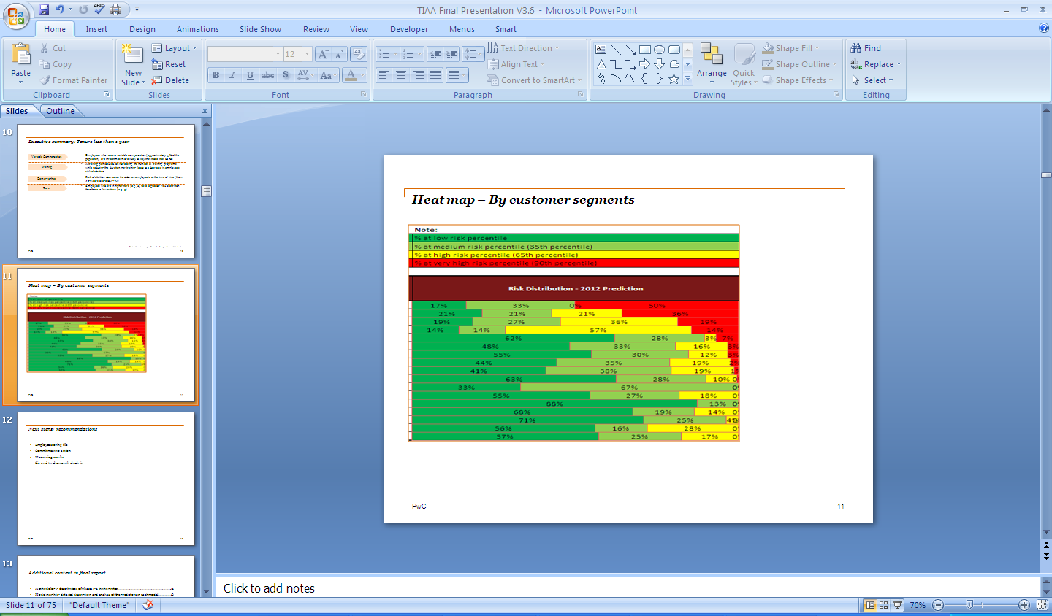
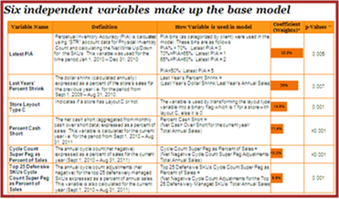
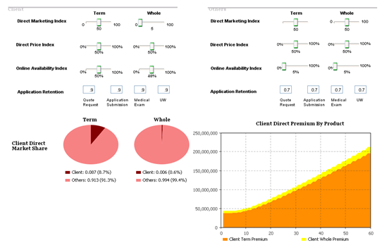
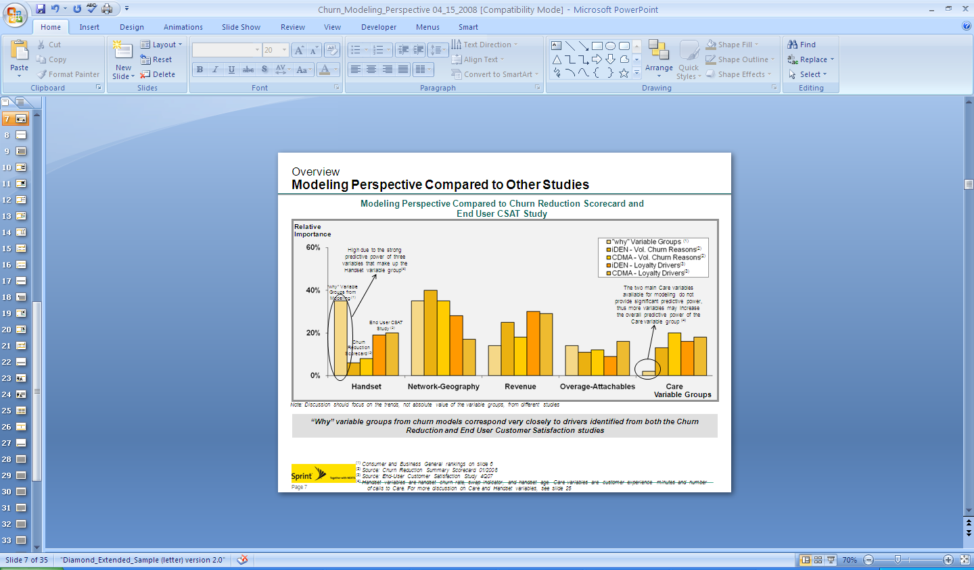
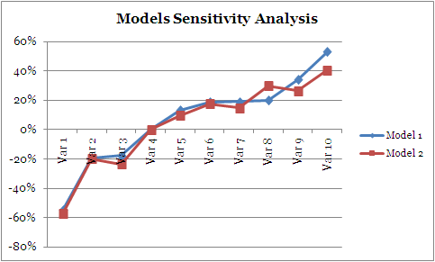
How PwC have helped clients
Data Quality Assessment
Developing sub models
Review of attributes
Assessing and tuning current models
Impact analysis of factors.
Risk Score Distribution charts and graphs
SME knowledge

Slide 24
Sanctions Screening
Mayur Dashani

Slide 25



What are Sanctions?
Sanctions are the government measures against Designated Persons, certain Transactions, and Countries.
1
Type of the sanctions
Sanctions on entities
Sanctions for specific purpose
2
Banks are requires to perform sanctions screening as part of:
Customer Screening Requirements
At on-boarding (as a minimum prior to the facilitation of any transactional activity)
On an on-going basis to compare against updates to sanctions lists
Payment Screening Requirements
Outbound payments – prior to the release of funds
Inbound payments – prior to the transfer of funds to the beneficiary /customer’s account
Factors to consider while implementing the sanctions:
Customer profiles
Service offerings
Complexity of transactions with which the firm is involved
Geographic markets (including legal requirements and sanctions)
Internal processes
Businesses should document their risk assessment and decisions made on the basis of such an assessment

Slide 26




Sanctions on entities
Types of entity
Individuals
Companies
Vessels
Example of entity
Name | Type | Country | Additional Info
SIEIRO DE NORIEGA, Felicidad | Individual | Cuba
NAJJAR, Mostafa Mohammad | Individual | IRAN | DOB 1956; POB Tehran, Iran; Additional Sanctions Information - Subject to Secondary Sanctions; Minister of the Interior; Deputy Commander-in-Chief of the Armed Forces for Law Enforcement.
SUDAN NATIONAL BROADCASTING CORPORATION | Companies | Sudan
GREEN LIGHT | Vessel | Syria | Vessel Registration Identification IMO 8810700; Linked To: MILENYUM ENERGY S.A.; Linked To: GREEN SHIPPING LTD.

Slide 27
Sanctions for a specific purpose
Prevent transactions involving specified purposes
Regulation Name | Sanction
UN Iraq Regulations | Shall not knowingly export, sell, supply or send to any person in Iraq arms and related material unless they are required by the Government of Iraq, or by a multinational force under unified command, to serve the purposes of Resolution 1546 of June 8, 2004.
UN Liberia Regulations | Shall not knowingly provide to any person in Liberia technical assistance related to the provision, manufacture, maintenance or use of arms and related material.
UN Democratic Republic of the Congo Regulations | Shall not knowingly export, sell, supply or ship arms and related material, wherever situated, to any person in the Democratic Republic of the Congo, or provide assistance related to those things.

Slide 28


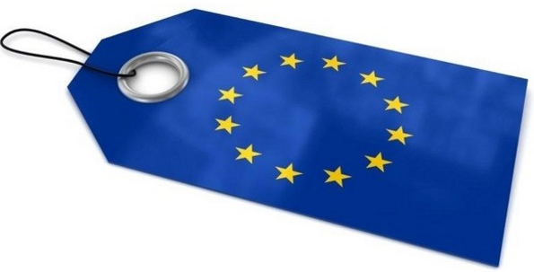

Sources of Regulations
Intergovernmental body (recommendation)
FATF: Financial Action Task Force (1989)
40 recommendations on AML (Anti-money laundering) and ATF (Anti- Terrorist Financing)
KYC (Know Your Customer) & CDD (Customer Due Diligence):
Filtering of new accounts (on-boarding) and on-going procedures
United Nations Security Council (UNSC)
European regulations
European Journal: JO / EUR 1294 / 1999 15-JUNE-1999
HMT List (Her Majesty’s Treasury): Bank of England
All UK individuals and businesses must comply with
financial sanctions requirements.
American regulations
OFAC List (1950)
U.S.A. Patriot Act - October 26, 2001 (new requirements)

Slide 29




Lists of Blocked Entities
OFFICIAL
THIRD PARTY
INTERNAL
HMT
EU
OFAC
SECO
Austrac
UNSC
World-Check
Factiva
World Compliance
Accuity
…
Bad debtors
Unreliable
counterparts
Blacklists/ greylists/ whitelists
…
Sanctions list
Private list

Slide 30
Overview of the Sanctions Screening Process
The dominant player in the market for sanctions screening is Fircosoft.
False Positives
Report SAR/ Block/ Reject
Data
Filter & Match
Alert
Investigation
Lists
Close Case
= Screening Software

Slide 31
Sanctions screening challenges
Why screening?
“Targets might use false information to evade detection such as varying the names of individuals and entities.”
Screening challenges
Periodic update of the watchlist
Consolidation of the watchlist from the multiple sources
Increase in volume the screening data
Providing inaccurate information by customer during KYC to evade detection
Screening different types of message e.g. Swift , Chips..
Increase in number of regulators
Increase in number of false positives

Slide 32
Group Activity 1
Nick Kawecki/Mayur Dashani

Slide 33
Activity – Risk rate the following Clients
You are working as a CDD and sanctions screening analyst in Group Financial Crime at global bank headquartered in London.
The following 6 clients are either new clients applying for products from the bank, or existing clients showing new behaviour.
For each of the following clients:
Identify ALL the CDD and sanctions risks presented to the bank
Assign a risk rating of high, medium, low or prohibited
Recommend an appropriate course of action, such as
Approve/reject application
Trigger re-review
Exit customer from bank
Raise SAR

Slide 34

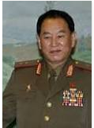




Activity – Risk rate the following Clients Identify the risks presented to the Bank
Jose Maria Marin
President of the Brazilian Football Confederation
Jose is an existing current account holder and frequently receives foreign payments.
Media reports link FIFA to a bribery and corruption scandal relating to international television rights to South American football.
Kim Yong-chol
Head of national intelligence for North Korea
Nephew of Kim Yong –Chol applies for a credit card.
Splash ‘n’ Dash Car Wash
Registered in Cayman Islands
Splash ‘n’ Dash is an existing commercial client registered in the Cayman Islands but operating in the United States. The owner is an unnamed trust fund.
The company issues bearer shares for the first time.
Stark Industry
New trade deal
Stark industries is a trade finance customer that receives a $10,000 payment from Syria for a shipment of dual-use goods.
Mariana Lopez
Wife to Ambassador of Panama,
Residing in UK
Diamonds Are Forever
Sierra Leone Diamond Trader
Diamonds Are Forever is a new company registered and operating in Sierra Leone that applies online for a business banking account.
Mariana was offered a position of branch manager in Santander bank at a branch in London.
Familial connections are discovered during on-boarding checks.

Slide 35

You have 15 mins!!!

Slide 36
Transaction Monitoring
Speakers:
Introduction to Transaction Monitoring – Natasha Mushfique
Scenario Selection – Robin Bhurton
Customer Segmentation – Jim Prevot
Threshold Tuning - Sonali Warriar

Slide 37
Introduction to Transaction Monitoring
Natasha Mushfique

Slide 38
Introduction
Transaction Monitoring (TM) refers to the identification of suspicious patterns of transactions
Effective TM systems became a regulatory requirement for Financial Institutions within the EU in 1991 when the first AML directive was issued requiring them to monitor suspicious transactions in order to tackle money laundering and counter terrorist financing
Overview of the Transaction Monitoring Process
Risk-based transaction monitoring requires the development of risk models or scenarios that identify the potential risks (“red flags”) of money laundering and provide a means of monitoring these risks within completed transactions.
An appropriate monitoring process will compare transaction information against:
identified risks
geographic location of transaction
the type of products and services being offered
the type of client engaging in the transactions
With the different typologies for money laundering and other illicit activities to determine if a transaction is unusual or suspicious.
Scenario Selection
DQ Assessment
Customer Segmentation
Threshold Tuning
Alert Investigations
Typology Assessment
Source System 1
Extract
Transaction Monitoring Database
Aggregate view of all data
SEGMENTATION
Segment A
MODELS
RULES
Scenario 1
THRESHOLDS
Alert 1
RISK SCORING
Score 100
Case Management System
Internal and External Data Sources
Score 90
Segment B
Score 80
Source System 2
Transform
Segment C
Scenario 2
Alert 2
Score 70
Segment D
Score 60
Segment E
Scenario 3
Alert 3
Score 50
Transactions
Risk Scores
Threshold
Score 40
Source System 3
Load
Segment F
Score 30
Segment G
Scenario 4
Alert 4
Score 20
Segment H
Score 10

Slide 39


Current Issues & Impact
Issues
When transaction monitoring to detect money laundering & counter terrorist funding first became a regulatory requirement for financial organisations, the technology was not mature and / or this was seen very much as a tick box exercise, this resulted in:
Low cost options for solution implementation sought, as unlike fraud, where investment in a solution does save money for the business, this was seen at the time as a direct cost overhead to the business
Lack of investment in skilled resources to maintain the models and identify emerging threats for monitoring
Solutions focused on raising of alerts and not on what it takes to investigate an alert
The impact of this is / was
Risk coverage (effectiveness)
Lack of understanding of risks
+ incomplete / poor data
+ poor feedback from investigations
= ineffective risk coverage
Operational cost (efficiency)
High volume of alerts
+ high false positive rates
+ long time to investigate
= high operational cost

Slide 40
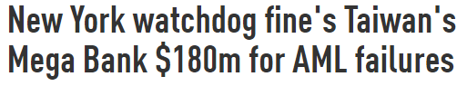
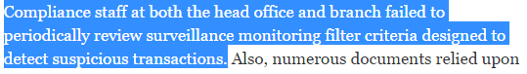
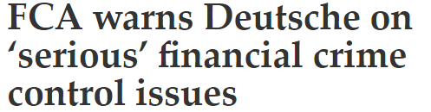
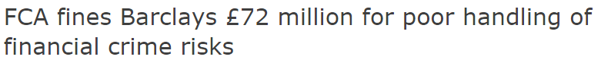
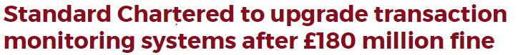
Current Issues & Impact
Further Impact:
Fines and ominous threats for FIs …
2016
2015
2014

Slide 41
Key considerations for effective surveillance
The following are some of the key considerations for the implementation of an effective transaction surveillance strategy
1
Typology review
2
Data quality
3
Analytics: Segmentation
Documenting financial institution’s risks (red flags) and mapping to detection scenarios and determining customisations to cover known risk areas.
As regulators review the various components of a compliance program, it is extremely important to ensure that a consistent, transparent and repeatable process is followed across various initiatives within a organization.
Analysing the customer and transactions data to determine critical areas for enrichment. Strategically planning to leverage a vendor solution or developing a rules-based enrichment engine in-house.
Developing segmentation models for KYC and KYCC (3rd party) customers for an effective surveillance system.
4
Analytics: Tuning thresholds
5
Operations: Case Management
6
Operations: TOM & MI
Developing and implementing an effective threshold setting methodology and implementing with appropriate analytics tools and data.
Implementing an effective case management solution in conjunction with surveillance is critical for an effective surveillance strategy, especially incorporating the feedback loop from the operational investigations.
Defining roles and responsibilities and the interactions between various operational groups for efficient management of the AML ecosystem. Identifying ownership for the end-to-end system is critical for governance.

Slide 42
Scenario Selection
Robin Bhurton

Slide 43
Why do I need a scenario selection process?
As a cautionary advisor, you cannot rely exclusively on applying an ‘implement all’ approach to detection scenarios. While they are common in many cases, each business has its own unique operating procedures. A thorough scenario selection process is necessary to factor:
Each bank should be considered on an individual basis to assess the organisation’s unique vulnerabilities and tailor the list of scenarios to the specific operation.
Risk Appetite
Line of Business (LoB) Operating Procedures
Reduce False Positives
One bank may not consider certain behaviour as risky. Monitoring this particular behaviour would not be useful.
Implementing a scenario would be a waste of resources if the LoB does not conduct the type of business monitored by the scenario.
Implementing all scenarios will increase the number of false alerts. This detracts resources away from true positives alerts, thus increasing the ML risk.

Slide 44
Scenario Selection Approach at a Glance
Review regulation
Red flag alignment
Solution guides reviewed
Risk matrix
Review major regulatory requirements and guidance
Identify red flags related to line of business
Identify associated risks and typologies related to relevant LoB at the bank
Align regulatory red flags with the identified risks
Review the detection scenarios from major transaction monitoring vendor solutions related to LoB and those implemented at other banks
Align selected scenarios with regulatory red flags
Compile the lineage of a risk through to a selected scenario into a risk matrix
Discuss risks and scenario during this workshop to agree prioritisation
Review LoB transaction types

Slide 45
Scenario Selection Approach – Review Regulations
Several global and national regulatory papers are available to extract red flags. It is important to use these documents to extract red flags as neglecting them may result in a penalty for the bank later on. In addition, a number of industry papers have been published that can also be good source of alternative red flags. Below are some common sources for red flags:
Regulatory and industry documents were reviewed
Federal Financial Institutions Examination Council (FFIEC)
Financial Action Task Force (FATF)
Financial Crime Enforcement Network (FinCen)
UK Financial Conduct Authority (FCA)
Joint Money Laundering Steering Group (JMLSG)
New York Clearing House Association (NYCHA) Guiding Principles
The Wolfsberg Group Correspondent Banking Principles 2002

Slide 46
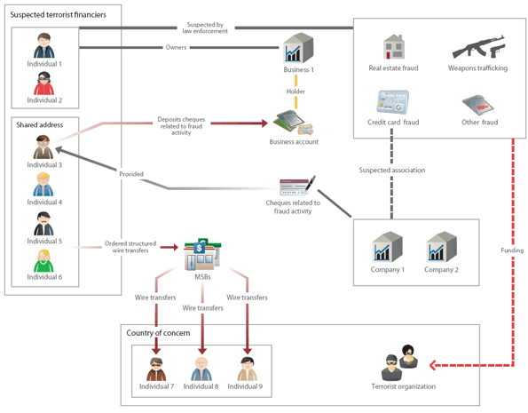
Red Flags Suspicious behaviour or activity which is typically associated with potential money laundering.
An Illustration of Potential TF from FINTRAC
Possible Red Flags
Multiple senders shared common address information.
Multiple senders sent funds to the same beneficiary in a country of specific concern for terrorism.
Senders conducted structured transactions within days of each other.
At least one individual involved in this case used multiple dates of birth (DOB), ID, and addresses to MSBs.
Notes:
Discuss why are these considered to be red flags – what specific behavior suggests potential for money laundering
Any of these activities may have a perfectly reasonable explanation.
An accumulation of red flags will require more information to explain why so many risk factors are present in a particular account.
It is important to note that all but the first two are relate to activities AFTER an account is open. There are two critical points here:
Solid CDD is the foundation of the AML/CFT programme. If it is defective, the rest of the programme, including the monitoring, will not be capable of producing the correct warnings and indicators.
Transaction monitoring and the processing of flags and indicators tripped is central to the programme.

Slide 47
Scenario Selection Approach – Align Red Flags to Typologies Once red flags are identified from industry papers for a line of business, these can be grouped into typologies. A typology is a categorisation of similar risks. Below are examples of common typologies:
High Risk Jurisdictions
Sanctions
Shell Banks
Deviation from Historical Profile
Unusual Transaction Activity
Change in Behaviour
Recurring Relationships
Stripping
Nested Accounts
Payable through accounts
Straight through processing

Slide 48
Scenario Selection Approach – Align Red Flags to Bank’s LoB
Not all Red flags will be relevant to the bank you are working with. To effectively align red flags to the prevalent risks, it is necessary to analyse the line of business you are working with. Some key points to consider are:
With this information – a picture of the line of service can start form and risks can be effectively aligned. Red flags that are not relevant to the line of service will at this point, be de-scoped.
Customer types
What type of customers will you find within the line of business?
Jurisdictions
Which jurisdictions are the line of business exposed to.
Products
What products are used within the line of business?

Slide 49
Scenario Selection Approach – Solution Guides
Once you have successfully filtered out non-relevant red flags, it’s time to assign detection scenarios! At your disposal are a number of reference sources. These include solution guides from leading solution vendors, Rulebooks from previous projects, and subject matter experts within the PwC network. Below are common sources used to identify scenarios:
Actimize
Mantas
Detica NetReveal
Detection scenario rulebooks
Industry knowledge

Slide 50
Scenario Selection Approach – Risk Matrix (Example)
Risk | Red flag description | Governing bodies | Level | Control | Potential scenarios or other Control | ID
High Risk Jurisdictions | Companies incorporated in or individuals residing in countries without adequate AML/CFT controls. | FATF FFIEC | Originator / Beneficiary | TM | Monitor for significant increases in activity or consistently high levels of activity with (to or from) high risk jurisdictions, and determining the rationale. | DS01
 |  | FATF FFIEC | Transaction | TM | Monitor for transactions originating and ending in a high risk country (based on country risk table). | DS02
 |  | N/A | Transaction | TM | Monitor for transactions involving Syria. | DS03
Heading | Description
Risk | The risk category to be mitigated against.
Red flag description | Description of red flags described from a range of regulation and guidance provided by inter-governmental bodies.
Governing bodies | Regulation and guidance describing specific red flags and industry expectations from inter-governmental bodies and steering groups.
Level | The level at which a potential scenario / control is to be calculated. E.g. either at an individual transaction level Customer level.
Control | Whether an automated transaction monitoring scenario can mitigate risk or whether other controls are required to cover (e.g. sanctions screening or ongoing due diligence (ODD) and on-boarding checks).
Potential scenarios or other control | Description of the scenario to be deployed or other controls used to mitigate the risk.
ID | Reference ID for the scenario. If relevant to a transaction monitoring detection scenario this is given the prefix ‘DS’ whilst when covered by other controls the prefix ‘OC’ is used.

Slide 51
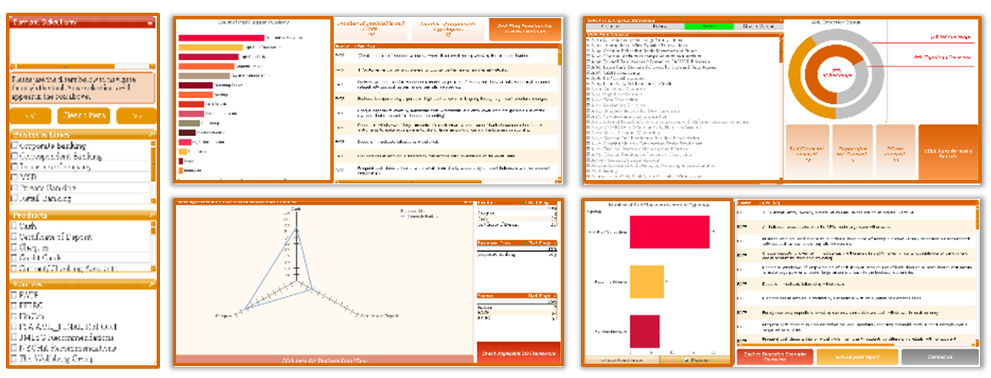
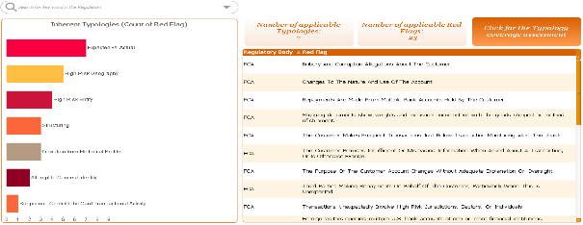
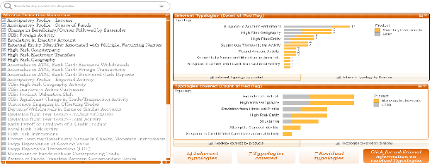
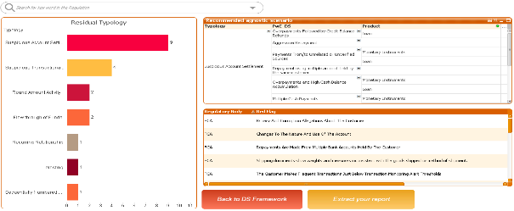
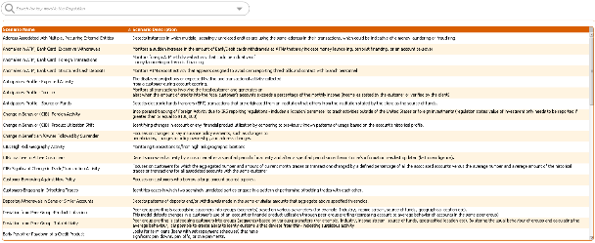
Scenario Selection Approach – Typology Tool
By combining the industry trusted lists, our industry expertise and analytical skills, we were able to create the AML Typology Tool. The AML Typology tool is an interactive tool that allow banks to identify inherent, covered and residual typologies based on the products & services offered and transaction monitoring detection scenarios in place. Moreover, based on the residual typologies identified, vendor agnostic scenarios will be recommended in order to pro-actively guide banks to reduce their exposure to Money laundering or terrorist financing activities.
Features
Filter boxes to select your Business Lines, Products and Regulatory sources.
Inherent typologies and red flags
Typologies covered broken down by divisions and products
Residual typologies and vendor agnostic detection scenario recommendation
Detection Scenario glossary
A
B
D
A
B
C
E
C
D
Key Benefits
The use of a dynamic dashboard allows a high level of flexibility and data drill down capabilities Ability to select appropriate detection scenarios to be implemented in order to mitigate risks. Identify potential enhancements to existing detection scenarios. Validate scenarios running based on the library of red flags mapped to business lines and products and typologies.
E

Slide 52
Segmentation
Jim Prevot

Slide 53



Segmentation - Definition and purpose
What is segmentation?
Segmentation is the process of grouping customers and accounts that are expected to transact similarly or have similar AML interest to allow risk focused threshold values for scenarios to be set for each subgroup
A well-defined segmentation model helps improve the output of the transaction surveillance system by improving monitoring coverage and reducing the number of false positives alerts raised
Pre-Segmentation
Post-Segmentation
All Customers
Corporations
Banks
# of Customers
Threshold
Threshold
Threshold
$22 M
# of Customers
$14 M
# of Customers
$25 M
Banks
Transaction Activity based Segmentation
Corporations
Banks
$1M $5M $10M $15M $20M $25M $30M
$1M $5M $10M $15M $20M $25M $30M
$1M $5M $10M $15M $20M $25M $30M
Monthly Transaction Activity $
Monthly Transaction Activity $
Monthly Transaction Activity $
With a single threshold for all customers, alerts will only be generated for Banks as no corporations transact above $22M
Separate segments have been created for Bank and Corporate customers
Thresholds can be now be defined for each segment
Scenario coverage has been increased based on individually defined threshold
All Customers
Corporations
Non-Profit Organisations (NPOs)
# of Customers
Threshold
# of Customers
Threshold
# of Customers
Threshold
$14 M
$14 M
$11 M
Corporations
Customer Risk based Segmentation
NPOs
$1M $5M $10M $15M $20M $25M $30M
$1M $5M $10M $15M $20M $25M $30M
$1M $5M $10M $15M $20M $25M $30M
Monthly Transaction Activity $
Monthly Transaction Activity $
Monthly Transaction Activity $
With a single threshold for all customers, alerts will only be generated for Corporations as no NPOs transact above $14M
Separate segments have been created for Corporations and NPOs
Thresholds can be now be defined for each segment
Scenario coverage has been increased based on individually defined threshold

Slide 54
Segmentation - Model Characteristics
Characteristics of an effective segmentation model
Uses a risk based approach – Customers with distinct money laundering risk profiles should be classified into separate segments, if applicable, to facilitate risk based monitoring. Entity types of special AML interest, as identified by regulatory agencies (such as Non-profit organizations), should be segmented separately to monitor them closely.
Utilises business characteristics – Customers/accounts within the same segment are expected to behave similarly. For example, If a segment is created for small-medium enterprises, then all customers in that segment are expected to have similar monthly turnover, hence can be monitored using the same set of thresholds. In the case where there is a single segment containing customers such as large corporations and small-medium enterprises, two negative outcome are most likely to be observed. As the threshold will be set taking into account the transaction undertaken by the small business and large corporations, it will firstly cause the threshold to often be too low for large corporations, generating an excessive amount of false positives, or too high for the small-medium business, resulting in none of those customers being monitored by the bank. It is also very important carry this review in conjunction with the risk based approach described in the above section. If a small-medium business is classified as a PEP, it will have to be segmented separately as a more conservative threshold will have to be set to reduce risk.
Exhibits distinct transactional behaviours – Each segment defined within a model should have a distinct transactional behaviour. This will ensure that distinct threshold values can be set for different segments as part of transaction monitoring through detection scenarios. Statistical measures like skewness and kurtosis can be used to understand the similarity and differences in transactional behaviours within and across segments.
Increases coverage – Segments should be defined in a way that coverage is enhanced by ensuring that customers/accounts who not alerting previously can become eligible for alerting. For example, if FI-Bank is a single segment in the current model, coverage can be increased in FI-Banks with lower transactional activity, by clustering the group into segments such as FI-Bank Low, FI-Bank High etc., and configuring lower thresholds for FI-Bank Low segment compared to FI-Bank high segment.
Has a reasonable number of segments – The segmentation model should have a reasonable number of segments such that the model is reasonably easy to maintain on an on-going basis. A segmentation model with too many segments could lead to difficulties with regards to maintenance of the model.
Has properly sized segments – Customers/accounts should be well distributed across the different segments within the segmentation model. Segments with too few entities (less than 30) should be consolidated if applicable and segments with too many entities should be considered for splitting into smaller segments.
Is Globally consistent – The segmentation model should be developed with a futuristic view of keeping the model globally consistent. However, exceptions can be made based on the different products offered by country / region or other local regulatory concerns.

Slide 55
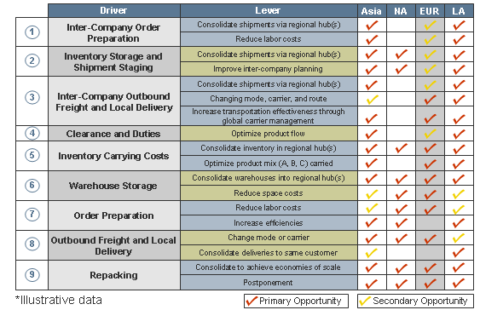
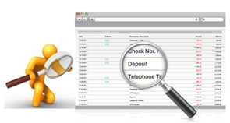
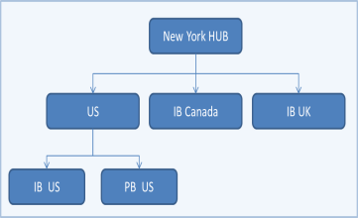
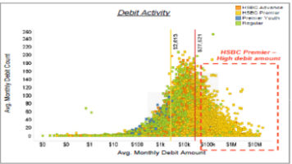
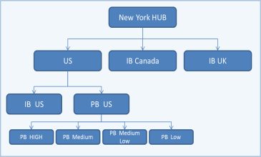
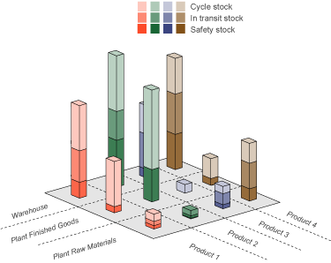
Segmentation - Methodology
Segmentation Methodology
Business Assessment
Qualitative Analysis
Initial Segmentation Model
Quantitative Analysis
Final Segmentation Model
Develop a thorough understanding of the Bank’s business operations and risks
Identify and analyse attributes that could be used to group customers/accounts
Define the initial segmentation model based on qualitative analysis of selected attributes and identification of special interest products and customers
Analyse the segmentation model using statistical techniques to check for similarity in transactional behaviours within segments.
Split/merge segments wherever applicable based on quantitative analysis methods
Define final segmentation model with stakeholder concurrence

Slide 56
Scenario Tuning
Sonali Warriar

Slide 57
Threshold Tuning Methodology
Prepare input data
Develop Scenarios
Statistical Analysis
Business Analysis
Filter transactions based on parameters relevant to the Line of Business
Apply statistical methods to calculated variables to identify points of statistical interest
Assess scenario output from a business perspective
Develop scenarios in test environment
Apply segmentation as identified through customer segmentation process
Execute scenarios to identify relevant transactions and create base datasets with calculated variables (e.g. monthly counts, total values etc.)
Deployment
Propose initial thresholds and prepare samples for business analysis
Conduct Above & Below The Line testing
Conduct mock investigations on samples above and below the line to determine threshold eficacy
Apply final thresholds for implementation in AML system
Validate scenario logic and apply business filters where necessary
Adjust thresholds, take new samples and re-test

Slide 58
Prepare Input Data & Develop Scenarios
Round Amount Payments Example
Purpose:
The purpose of this scenario is to detect behaviour when a customer displays unusual money laundering activity characterised by making multiple round amount transactions. This has been stated in many industry guidance documents as a potential red flag for money laundering.
Example Threshold:
Threshold 1 : Minimum number of round amount transactions per month per pseudo customer
Scenario Development:
Consider transactions of customers relating to round amounts only ( check divisibility of amount by 10,100,1000, etc.)
Segment customers as defined during the segmentation process
Create datasets with calculated variables – in this case, a dataset containing the number of qualifying transactions per month for each customer

Slide 59
Statistical Methods
The two statistical methods are jump analysis and outlier analysis
Jump analysis is utilised for continuous variables (amounts) and outlier analysis for discrete variables (counts)
In certain cases, a hybrid approach may be adopted where both methods are utilised together.

Slide 60
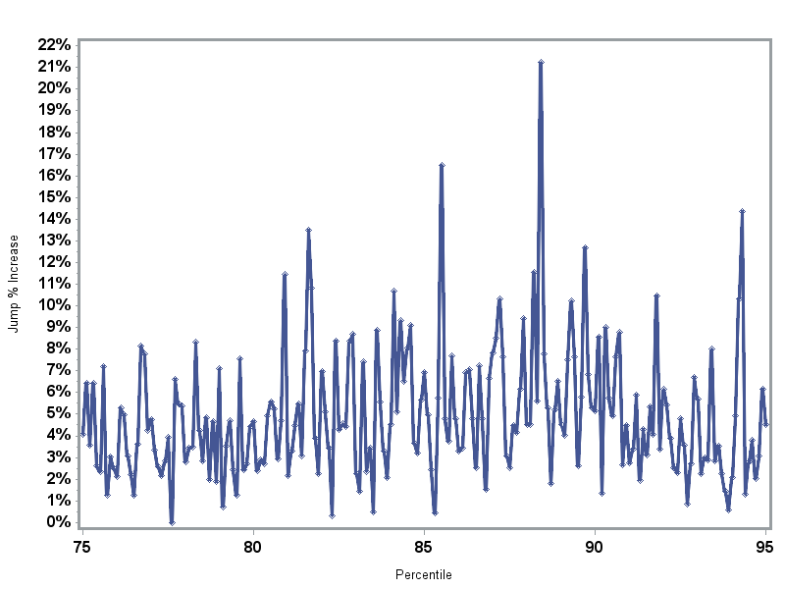
Statistical Methods – Jump Analysis
Overview
Segment dataset into percentiles ranging from 0 to 100 based on the calculated variable of interest (e.g. total number of round amount transactions per month per customer)
Calculate the percentage change between each percentile group. For example: Jump at 80.1 = Value at 80.1st Percentile – Value at 80th Percentile Value at 80th Percentile
Identify percentile with largest jump and get corresponding value
Largest Jump
Jump % Increase
Percentile

Slide 61
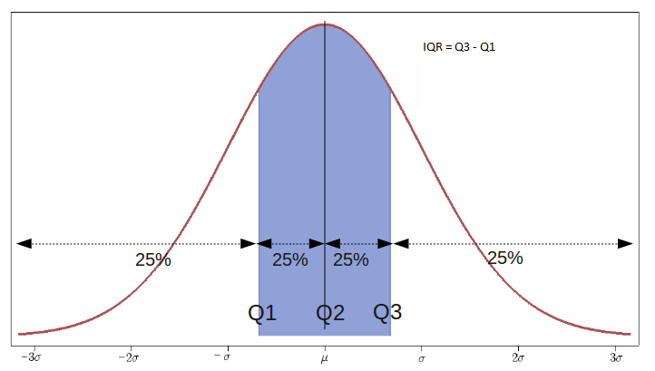
Statistical Methods – Outlier Analysis
Calculate Interquartile range (75th Percentile – 25th Percentile) of the dataset
Outlier = P75 + 1.5 * IQR
Extreme Outlier = P75 + 3 * IQR (N.B. The formulae for outlier and extreme outlier are industry standards)
IQR
No. Observations
Outlier
Extreme
Outlier
1.5 * IQR
3 * IQR
Calculated Variable

Slide 62
Statistical Methods – Hybrid Approach
Check percentiles of outlier and extreme outlier values
Jump dataset:
If outlier is at the far end of the distribution, take Q3 (75th to outlier as the jump dataset)
If not, use outlier to extreme outlier as the jump dataset
Calculate jump within the target dataset region
No. Observations
Outlier
Extreme
Outlier
Jump
Jump
Calculated Variable

Slide 63
Statistical Methods – Which technique to use?
Depending on the client, there could be two ways in which these techniques are employed:
SARs have been raised
Continuous Variable : Set the baseline threshold to the minimum value at which a SAR was raised and perform jump analysis between this value and the value 10 percentiles below it. The largest jump will be the initial threshold.
Discrete Variables: Set the initial threshold to the minimum value at which the SAR was raised
No SARs have been raised
Continuous Variable : Utilise the hybrid approach to calculate the largest jump. This will be the initial threshold.
Discrete Variables: Utilise the outlier method to calculate the 75th percentile, outlier and extreme outlier values for review by the business. Set one of these as the initial threshold.

Slide 64
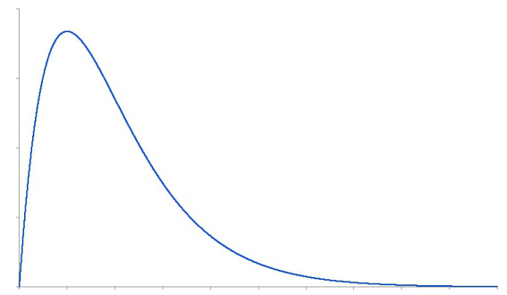
Business Analysis – Above and Below The Line testing
Overview
Statistical analysis identifies points of interest in data distributions which can form the initial settings for threshold, however business logic must be applied to validate thresholds and ensure that the real AML risks are being addressed
Above and Below The Line testing examines whether unusual cases worthy of investigated are being raised as alerts, and that cases that are not raised do not necessitate investigation.
Methodology
Samples are taken using the following approaches:
Below the Line: Population between the Variable 1 threshold and 10% below
Above the Line: Population between than Variable 1 Threshold and 10% above N.B. Variable 1 refers to the variable of interest on which the threshold is applied, i.e. Count of transactions, Transaction Amount, etc.
Single Variable
Samples
Count
BTL Population
ATL Population
Variable 1 Threshold
10% below
Variable 1
Threshold
Multiple Variables
Variable 1 Threshold
Variable 2
Above
the Line
Variable 2 Threshold
Below
the Line
Variable 1
10% below Variable 1 Threshold
10% above Variable 1 Threshold

Slide 65
Business Analysis – Above and Below The Line testing
Testing
Scenario logic is used to identify statistical unusual cases. Initial thresholds are set so that cases below the line are regarded as statistically ‘normal’; whereas cases above the line are abnormal.
These cases (“test cases”) are analysed by the business for validation. Interesting cases are identified and processed through the investigation procedures.
In the ‘above the line’ sample, a desirable result would be a low number of false positives and a high degree of unusual cases that are potentially suspicious.
In the ‘below the line’ sample, a desirable result would be a low number of unusual cases, and no cases that were deemed suspicious after business analysis.
Response
If a high frequency of false positives are found above the line, and results below are satisfactory, thresholds may be increased in the next iteration of threshold calibration.
If there are any suspicious cases or a high number of unusual cases below the line, thresholds may be decreased in the next iteration of threshold calibration.

Slide 66
Activity (Suspicious…)
Split into two groups
Each group will have a handout with a list of transactions
In the next 10 minutes, use the transactions to:
Identify possible segments that could be used (for example, country)
Understand how, within each segment, the thresholds vary with risk (for example, high risk countries would need lower value thresholds than low risk countries)
Determine which customers are displaying suspicious behaviour based on the detection scenarios given on the next slide
In the following 5 minutes, the two teams will present their results

Slide 67
Activity (Suspicious…)
Detection Scenario | Description
Deviation from Historical Profile (Amount) | The purpose of this scenario is to detect a change in the value/amount of transactions by a customer compared to their previous average activity.
Round Payment Transactions | The purpose of this scenario is to detect behaviour when customers displays potential money laundering activity characterised by making multiple round sum transactions.
U-Turn Payments | The purpose of this scenario is to highlight payments that are made to and from the same country but with an intermediary in a different country. This may indicate money laundering activities through currency substitution/clearing transactions through a foreign currency.
Recurring relationship – one to one | The purpose of this scenario is to monitor hidden and potentially exclusive relationships between two entities by detecting patterns of recurring transfers between an originator and beneficiary.

Slide 68

60 minutes and counting…

Slide 69
Trade-Based Money Laundering (TBML)
Speakers:
Jim Prevot
Nick Kawecki

Slide 70



TBML - What is Trade Finance?
Definition
Trade or export finance concerns international and national trade transactions – when a buyer purchases goods or services from a seller, the financial activities involved come under the umbrella term ‘trade finance’.
Expected

Slide 71
TBML - What is Trade Finance?
Definition
In reality, Trade Finance involves many different entity as well as many documents which are often paper based and easily tampered
REALITY
Advising Bank (could also be XX)
Issuing Bank
(Non XX)
3. LC issuance
a. Confirming LC
Unknown Third Party
a. Confirming LC
8. Release Documents
9. Payment
4. Advises the exporter a LC was issued
Nominated Bank (Authorised by Issuing Bank)
b. Payment
11. Release Shipping Documents
2. Importer requests LC
13. Payment at sight or usance
7. Payment
Exporter’s XX Account
6. Presents Shipping documents
1. Agreement
8. Exporter / Seller Distributes XX Funds
Exporter / Seller
(XX Client)
Importer / Buyer
Third Party
5. Shipment
12. Delivery

Slide 72
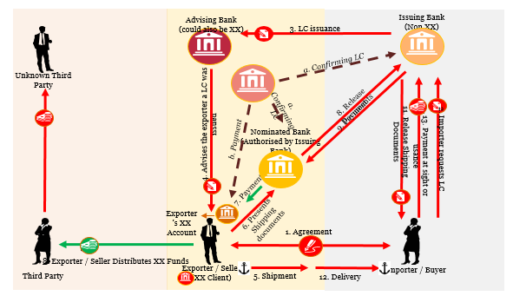
TBML - What is Trade Finance?
Definition
Trade or export finance concerns international and national trade transactions – when a buyer purchases goods or services from a seller, the financial activities involved come under the umbrella term ‘trade finance’.
Expected
Reality
Activities
Key Characteristics
Export/Import Financing
Issuing letters of credit
Factoring
Export credit insurance
Paper intensive
Large scale transaction
Low level of transparency/communication across borders
Extremely hard to monitor
Growing regulatory focus but still far away from an efficient solution
Export credit insurance
Money Launderer’s favourite playground

Slide 73
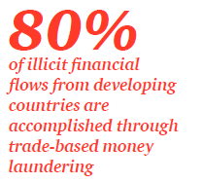
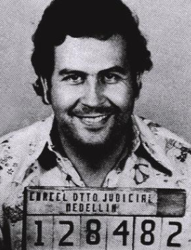
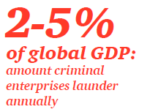
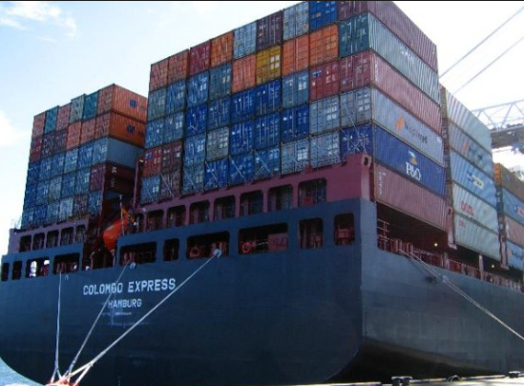
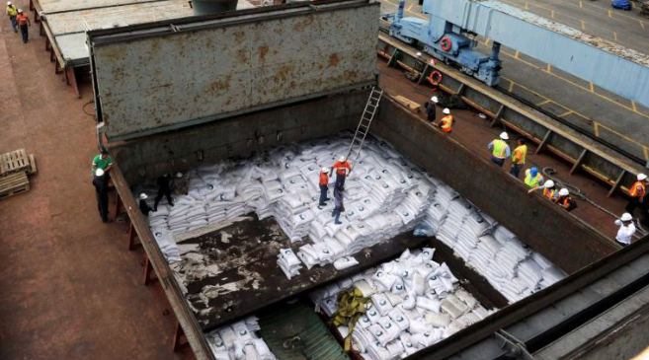
What is Trade Based Money Laundering?
Trade-based money laundering is defined as the process of disguising the proceeds of crime and moving value through the use of trade transactions in an attempt to legitimise their illicit origins.
Notes:
80% - Global Financial Integrity organization

Slide 74
TBML Methods
1. Over and Under invoicing:
Misrepresentation of the price of goods or service in order to transfer
additional value between the
importer and the exporter.
2. Multiple invoicing:
By invoicing the same good or service multiple times, a money launderer or terrorist
financier is able to justify multiple
payments for the same shipments.
This will often involve multiple banks.
Over Under invoicing
Multiple invoicing
TBML
3. Falsely describes goods
A money launderer can
state a good on the shipping
documentation but ship
something different. This can
involve sending completely different
goods to what stated on documentation
or simply falsely describing the quality of a good (e.g. gold vs silver)
Over under shipment
Falsely described goods
4. Over and under shipment
A money launderer can
understate or overstate the
quantity of goods being shipped.
In the extreme an exporter may not
even ship any goods at all while ensuring
that all shipping documents are still issued
and payments made.

Slide 75
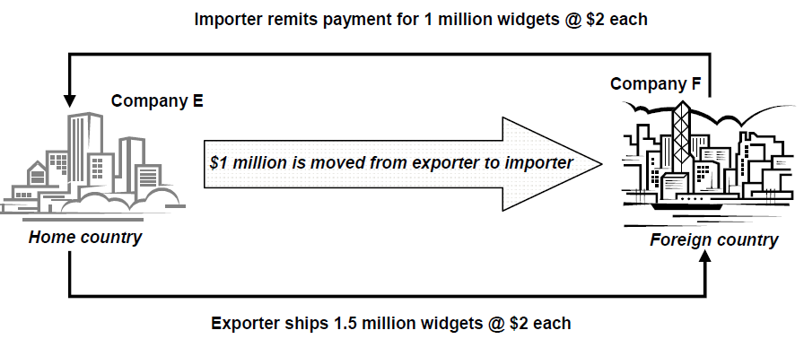
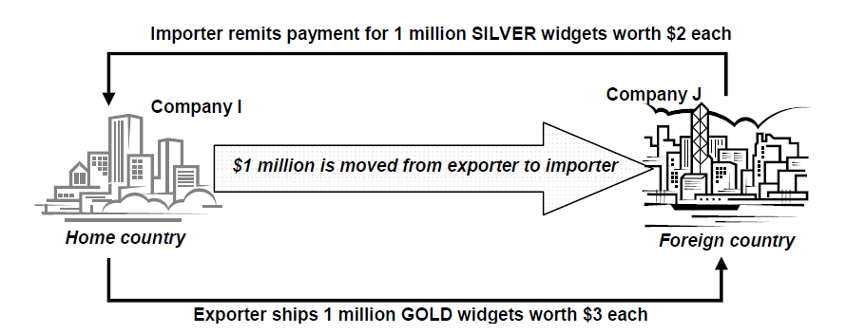
TBML methods explained
Under invoicing
Falsely described goods
Source: FATF

Slide 76
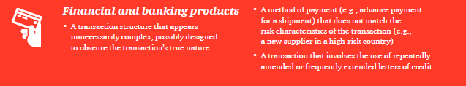
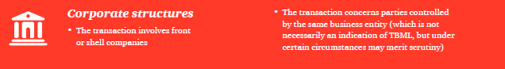
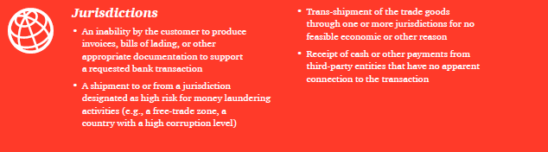
TBML Red flags

Slide 77
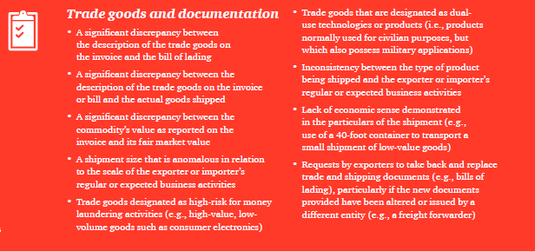
TBML Red flags

Slide 78

Black Market Peso Exchange
US Exporter
Money Service Business’s bank
Money Service Business
Money Service Business’s bank
Colombian Importer

Slide 79
Activities - How to stop Escobar?
Rule
Create 3 Teams
Looking at the black market Peso exchange, think of what controls may avoid the illicit money to be going undetected.
This is what we know-
1 exporter in the US that needs to be paid in US
1 Colombian importer that needs dollars to pay a US exporter (TIP: Money Service Business are generally seen as High Risk customers)
1 Money Service Business with multiple bank accounts in the US and is willing to collude (TIP: Money Service Business are generally seen as High Risk customers)
An army of dealers in the US ready to sell the drug and deposit the cash in the MSB’s bank
Banks with a reporting threshold of $10,000 transaction
3 questions per team.

Slide 80
Fraud, ABC and Market Abuse
Speaker:
Jeremy Davey

Slide 81
Fraud
Jeremy Davey

Slide 82
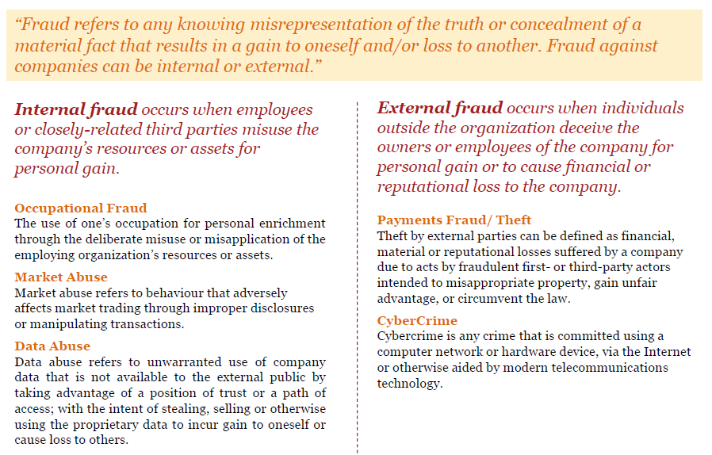
Definition of fraud

Slide 83
Motivation of fraud - The Fraud Triangle (Cressey, 1973)
Pressure
Personal or professional
Non-shareable
Always involves some form of disgrace, shame or embarrassment for failure
Opportunity
Deprival and concealment
Abuse position to resolve the pressure driving them to commit a crime whilst remaining undetected
Rationalisation
Justify why committing the crime
Feeling underpaid or aggrieved by employers, providing for family, or simply "borrowing" money
Converts long term employee into criminal
Opportunity
Rationalisation
Pressure

Slide 84

Insurance Fraud
Industry Shortcomings
ABI estimates that undetected fraud is £2.1bn adding £50 to £100 average premium
The Swedish National Council for Crime Prevention (Brå) reports denied payment in the amount of approximately
SEK 400 to 500 million
FFI reported on average 5 to 10 percent of claims contain information that requires further investigation
Insufficient feedback mechanisms to educate front-line staff about newly identified red flags to look for
Lack of appropriately skilled analysts/investigators, for increasingly complex and sophisticated frauds
Fraud costs Ireland
an estimated €200 million annually
People
Insufficient procedures during First Notice Of Loss (FNOL) stage, policy inception, first outbound call, claims process, and pricing triage processes.
Excessive fraud leakage through inefficient claims handling processes.
Upstream fraud detection is restricted by impacts to customer journey.
Process
ALFA estimate that fraud 15% of claims paid, or 4-8% of premium collected equating to €2.5bn
Limited use of voice to text analysis to utilise the rich content contained within adjusters and investigators note, such as claim circumstances and injury data and hence detection is reduced by not analysing them comprehensively
Limited use of external data to reveal relationships across relevant but distributed data sources.
Poor application of social network analysis to reveal relationships across claims and policy data
Technology
ICEA insurance investigation group reports a total of 155,994 fraud attempts were discovered by the insurers in2014, While the claims placed in these cases were for more than €586 million
Data quality is often poor, impacting the ability to identify fraudulent claims
Data is stored in several data siloes, preventing a holistic view of claimants, policyholders and third parties across the business
Data
Helvetia Patria reports that 10% of all claims are fraudulent amounting to about CHF 1bn every year
ANIA reports the average share of claims exposed to risk of fraud was 14.1% nationwide.
GDV estimates that fraud costs circa €4bn per annum
Insurance fraud is not a victimless crime

Slide 85
Banking Fraud - Fraud Taxonomy By reviewing various fraud typologies, it is possible to assess the levels of control and mitigation against the different risks. The lists below represent the most relevant fraud typologies to retail and commercial banking.
External
Internal
Account compromise
Account takeover
ID theft / impersonation
Power of attorney / relatives
Business email compromise
First party fraud – new account / bust out
Card fraud (ATM/POS)
Contact centre fraud / social engineering– update details (address, phone, email) / new card / liquidate assets
Check fraud (counterfeit / altered / forged)
Online and mobile banking – malware / phishing / SMSishing / rogue apps
Self payment authorisation
Bogus account creation
Asset misappropriation (skimming / check tampering / payroll)
Data theft
Unauthorised access
Interception
Bribery and corruption
External fraud occurs when individuals outside the bank deceive the owners or employees for personal gain or to cause financial or reputational loss to the company.
Internal fraud occurs when employees or closely-related third parties misuse the bank’s resources or assets for personal gain.

Slide 86
Fraud opportunities through customer lifecycle
Application
Onboarding
Product Usage
New Products
Detail updates
Customer Exit
Account takeover
ID theft / im\personation
First party fraud – new account / bust out
Bogus account creation
Bribery and corruption
Account takeover
Power of attorney / relatives
Online and mobile banking – malware / phishing / SMSishing / rogue apps
Account compromise
Card fraud (ATM/POS)
Check fraud (counterfeit / altered / forged)
Self payment authorisation
Account takeover
ID theft / impersonation
Business email compromise
First party fraud – new account / bust out
Online and mobile banking – malware / phishing / SMSishing / rogue apps
Interception
Contact centre fraud / social engineering– update details (address, phone, email)
Power of attorney / relatives
Online and mobile banking – malware / phishing / SMSishing / rogue apps
Data theft
Unauthorised access
Account compromise
Online and mobile banking – malware / phishing / SMSishing / rogue apps
Data theft
Unauthorised access

Slide 87
Evolution of technology in fraud prevention and detection New tools and technologies have allowed more complex analytics to build upon previous successful approaches to enhance capabilities
Streaming analytics
Behavioural analytics
Unsupervised learning techniques to surface up unknown risks
Clustering to detect anomalies including in rapid time series data
Self-learning algorithms reduce need to refresh models
>70%
Incremental benefit as best practices incorporated into evolving technology
Hadoop
Reduction in false positives
Link analysis
Entity resolution across customer and transaction records
Fuzzy logic to detect ID manipulation
Uncovering criminal networks and patterns across multiple datasets
NoSQL databases
Graph databases
Holistic view of risks factors
Predictive modelling
Neural networks to build scoring models across multiple risk factors
Continually update models with investigator decisions
Peer group segmentation to define normal behaviour
1/2
Relational databases
Alert handling times
Rules based
Identifying transactions over set thresholds
Detect payments to high risk businesses and countries
Use of black and white lists plus suspicious merchants
Increase coverage cf. manual approaches

Slide 88
Bribery & Corruption
Jeremy Davey

Slide 89
Bribery Act (2010)
Offering, promising or giving a bribe
Requesting, agreeing to receive or accepting a bribe
Bribing a foreign official
Failing to prevent bribery
Section 1
Section 2
Section 6
Section 7
Enforced by the Serious Fraud Office (SFO)
Currently looking into lavish hospitality; maintain proper books and records and keep total transparency of payments and hospitality (including whom it was given to)
Prison sentences can ensue
FSA conducted a thematic review of ABC controls in investment banks (2012)
Particular concerns included:
monitoring of third parties (especially PEPs),
senior management information dissemination,
assigning ownership to a bribery officer.
lip service paid to “zero tolerance” but a reactive approach only… tailored approach should be used instead of box-ticking exercise.
4 Offences

Slide 90
Failure to prevent bribery (Section 7)
Section 7 of the Bribery Act created a new offence which can be committed by commercial organisations
Failure to prevent persons from committing bribery on their behalf
It is a full defence for an organisation to prove that despite a particular case of bribery it nevertheless had adequate procedures in place to prevent persons associated with it from bribing
The Ministry of Justice (MoJ) published guidance about procedures which commercial organisations can put in place to prevent persons associated with them from bribing.
Set an appropriate “Tone from the top”
Top-level commitment
Due Diligence
Communication (incl. training)
Policy and procedures
Risk assessment
Monitoring and Review
Assess nature & extent of bribery risks for all associated parties
Conducted regularly
Risk based approach
Covers all who perform services for or on behalf of company
Review and test procedures
Update where necessary
Clear, practical & accessible
Zero tolerance
Includes expenses & hospitality policies
Publish Codes of Conduct
Tailored training
Training for all incl. board

Slide 91
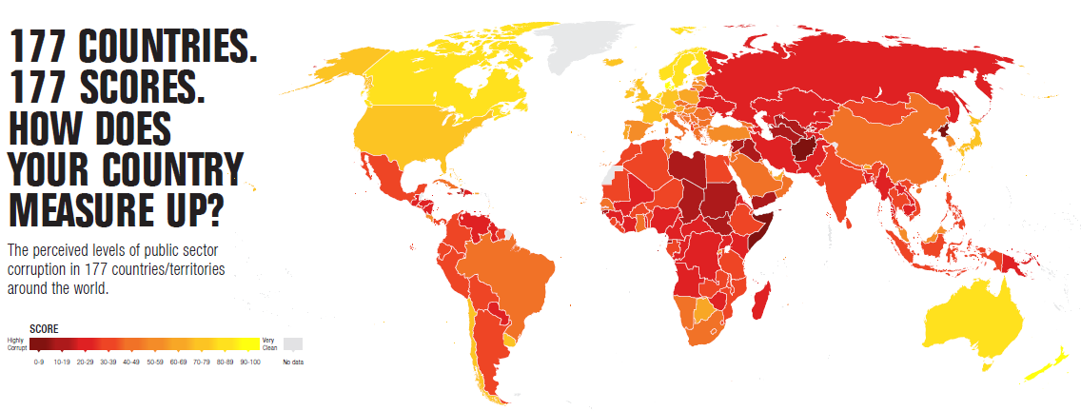
Intergovernmental bodies
Transparency International http://www.transparency.org.uk/
International non-governmental organization and consists of locally established independent organisations
Produce an annual report on Corruption Perceptions
FATF
40+9 recommendations on money laundering are aligned to fight corruption (see also money laundering)
Overseas Anti-Corruption Unit (OACU)
Global remit to investigate allegations of UK companies and individuals involved in Bribery in developing countries overseas
Since the creation of the unit in 2006 over 155 case of corruption or bribery have commenced with over 115 suspects under investigation, leading to the interview and arrest of 80 individuals, the charging of 28 suspects and 1 corporate entity.​
Draws on 13 different surveys and assessments from 12 different institutions including: Global Insight, Political Risk Services, the World Economic Forum, the World Bank and the World Justice Project
Based on expert opinion, the index measures the perceived levels of public sector corruption in countries, scoring them from 0 (highly corrupt) to 100 (very clean).
2013 Index presents more than two-thirds of the 177 countries score less than 50

Slide 92
Effects of corruption
Deepens poverty
Lowers quality and availability of public services
Increases political instability
Lower literacy rates, higher mortality rates and overall worse human development outcomes
Money Laundering is also associated with the proceeds of bribery.
Banks have a large part to play in this.
Examples
Ma Sin-chi, Deutsche Bank AG (DBK) (2013)
FCA fined £1.8million for failing to have in place appropriate checks and controls to guard against the risk of bribery or corruption when making payments to overseas third parties.
Willis Limited (2011)
Siemens AG (2008)
Managing director in Hong Kong
sentenced to seven years in jail for accepting HK$24.8 million ($3.2 million) in bribes.
Accepting the payments in exchange for information on derivative warrants issued by the bank.
JLT Specialty Limited (2013)
Had the checks in place but did not use them effectively.
£6.895 million fine for failings in its anti-bribery and corruption systems and controls
Payments made by Willis Limited to overseas third parties could be used for corrupt purposes
Lack of due diligence, lack of recording of payments and commercial rationale
Risk assessment not appropriately conducted and Senior Management not aware
Paid $16m to Argentinian president for contract to make ID cards ($1b) > $100m to government officials
$1.6b fines in US (DoJ) and Germany

Slide 93
Market abuse
Jeremy Davey

Slide 94
Market abuse offences
Insider dealing
Improper disclosure
Misuse of information
Manipulating transactions
Manipulating devices
Dissemination
Distortion and misleading behaviour

Slide 95
What is an ‘insider’?
An ‘insider’ is any person who has inside information potentially gained from an abuse of position:
Sitting on the board of or being senior management at an issuer of investment
Having information through employment, profession or duties
Through criminal means
Being tipped off by a ‘friend’
An insider can be either a primary or secondary insider.
Secondary insiders are persons who receive information, either directly or indirectly, which they know is inside information as it has come from or via a source which obtained that information by abuse of position
Defences
The only defences against insider dealing are:
Did not expect to result in profit
Would have conducted the same actions even without the information
Information disclosed widely enough to ensure no prejudice
A criminal offence requires intent, but under the civil regime you can do it accidentally; you don’t need to have any intent to commit market abuse.

Slide 96
Investigation by the SFO
Market abuse investigation is conducted by the Serious Fraud Office (SFO)
SFO operations handbook states that investigative evidence could come from:
Review of phones and computer and email accounts
Evidence from securities exchanges at the time
Analysis of share price
Witnesses
Analysis of trading records
Banking records to prove the money trail
Example :
Rajat Gupta Ex McKinsey partner and Goldman Sachs board member
Rapidly sharing insider information on GS with close friend
Received 2 years in prison
Tim Power Leaked price-sensitive information to a business acquaintance about the £9.8million acquisition of Belgo by Lonsdale Holdings
Whistle blown by “love rival” (love triangle involved)
James Sanders Who owned and was a director of now-defunct brokerage Blue Index
Used information gleaned from family connection- senior partner at Deloitte (M&A)
Jailed for 4 years, wife and business partner each received 10 months

Slide 97
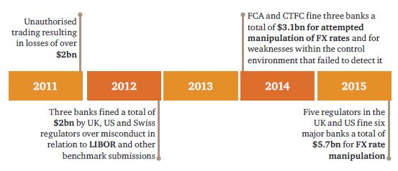
Rogue trading
Rogue trading events have had a substantial impact on investment banks over past two decades.
Impacts include:
Financial losses
Regulatory fines
Reputational damage

Slide 98
Factors that supported rogue trading incidents in the past
Traders had sizeable, complex, sensitive and speculative positions
Trader position
Frauds were committed by individual front office traders – no collaboration with other traders
Traders had knowledge and access to middle and back office systems and/or processes
Weaknesses in controls over traders’ ability to cancel, correct or amend trades allows concealment of unauthorised activity
Trader action
“Doubling up” of positions when the market moved against the positions
Loss making positions were hidden
Trades booked or amended excessively outside trading hours
Société Générale (2006-2008): Kerviel closed the trades just before the trades' timed controls would trigger notice from the bank's internal control system
Relevant examples
UBS (2011): Adoboli was suspected to have used the fact that some ETF transactions in Europe are not issued confirmations until after settlement has taken place. Invented “fake” counterparties . Traded “off-book” and beyond limits.
AIB (2002): Rusnak entered false options into the system that made it look like his unhedged positions were hedged

Slide 99
Emerging surveillance and monitoring requirements What is driving the need for new surveillance solutions?
Many incidents and regulatory changes require additional surveillance
or monitor-
ing, but who and how the
surveillance
should be
executed is difficult to manage.
Front Office
Operations, Risk & Finance
Sales & Marketing
Order Management
P&L
Settlement & Clearing
Pricing
Markets & Exchanges
Risk
Client Reporting
FX Fines
New surveillance or monitoring
Supervisory Controls & MI
Comms Surveillance
… but often there is overlap between initiatives
Rogue Trade Incidents
Compliance & Legal
HR
Internal Audit
Trade & Market
Legal
Recruiting
Risk Assessment
Financial Crime
Regulatory Compliance
Perfom.
Mgt
Testing
FCA Conduct
Trader & Employee Surveillance
Conduct & Culture
*Examples

Slide 100
You have 15 mins!!!

Slide 101
Future of banking
Speaker:
Mayur Dashani

Slide 102
New Payment Methods
1
01
These funding methods may allow complicit third parties to fund the prepaid cards or the IPS accounts willingly
Third party funding (including strawmen and nominees).
02
A number of submitted cases feature prepaid card and IPS providers or their employees, which are controlled by criminals and wilfully or recklessly assisting money laundering and terrorist financing activities. In such cases, market entry restrictions such as fit and proper tests have failed or are not applicable to the respective entity under that jurisdiction.
New payment method
3
Exploitation of the non-face-to-face nature of NPM accounts.
Complicit NPM providers or their employees.
03
In a number of cases NPM products were used to launder illicit proceeds gained from fraud following identity theft or from stealing money from bank accounts or credit/debit cards using computer hacking or phishing methods.
2

Slide 103
Future of banking : New payment method cases
Third party funding (including strawmen and nominees).
Case : Possible use of prepaid cards for terrorist financing purposes
A father and his son, suspected to be operating as money remitters, held numerous prepaid cards which were charged daily from all over Italy. Shortly after, the sums were withdrawn so as the cards accounts’ balances were almost always near to zero. A portion of the sums withdrawn from the prepaid cards was transferred to a bank account held by the father; funds were also credited to the same bank account from Pakistanis. The funds on the account were further used to order credit transfers. Both persons were found to be involved in the terrorist attacks which occurred in Mumbai in 2008.
Source: Italy.
Complicit NPM providers or their employees.
Case 20: Use of “ghost employees” to launder illicit funds through prepaid cards
In 2009, a defendant was charged with embezzling from his employer and laundering the stolen funds through prepaid payroll cards. The defendant, a manager with a janitorial service, interviewed job applicants for the purpose of stealing their personal information which he used to create fake employment positions which came with prepaid payroll cards. The defendant kept the payroll cards, using them to withdraw money from ATMs and purchase goods. In three years, the defendant laundered about USD 200 000. The defendant has not yet been tried.
Source: United States.

Slide 104
Future of banking : New payment method cases (cont.)
Exploitation of the non-face-to-face nature of NPM accounts.
Case : Money laundering through a digital precious metals provider
In 2008, an Internet-based digital currency business, and its three principal directors and owners, pleaded guilty to criminal charges relating to money laundering and the operation of an illegal money transmitting business.
Several characteristics of the digital currency business operation made it attractive to users engaged in criminal activity, such as not requiring users to provide their true identity, or any specific identity. The digital currency business operation continued to allow accounts to be opened without verification of user identity, despite knowing that the business was being used for criminal activity, including child exploitation, investment scams, credit card fraud, money laundering and identity theft. In addition, the digital currency business assigned employees with no prior relevant experience to monitor hundreds of thousands of accounts for criminal activity. They also participated in designing a system that expressly encouraged users whose criminal activity had been discovered to transfer their criminal proceeds among other accounts of said digital currency business. Unlike other IPS providers, the digital currency business operation did not include any statement in its user agreement prohibiting the use of its services for criminal activity.
Source: United States..

Slide 105
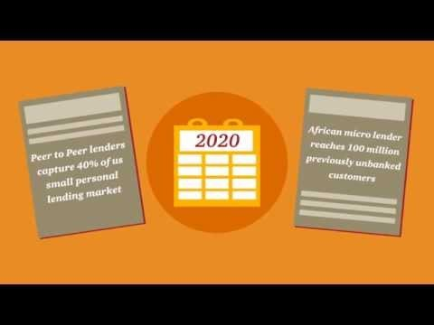
Future of banking by PwC

Slide 106
New Vendors
Speaker:
Sonali Warriar

Slide 107









Vendor relationships Building relationships with 3 main vendors but keep a holistic view of the market
JBR signed
DB case management discussions
Danske RFI
RBS targeting
Go to market regions
JBR in process
Intro to gaming practice
Whitepaper in process
JBR signed
SCB voice RFI
Citi opportunity

Slide 108
NICE Actimize – AML solutions
Anti-Money Laundering (AML)
Fraud Detection & Prevention
Financial Markets Compliance
Enterprise Risk Case Management
Technology
Suspicious Activity Monitoring
Customer Due Diligence
FATCA Compliance
Watch List Filtering
CTR Processing & Automation

Slide 109
Featurespace – Fraud & Transaction Monitoring
ARIC engine (Adaptive, Real-time, Individual, Change Identification) - Utilises machine learning and behavioural analytics to understand the “good” behaviour of customers
Features:
Recognises subtle anomalies in real time
Reduces the number of transactions that get unnecessarily blocked
Models self learn as fraud evolves & do not degrade over time
Legacy business rules can be implemented within ARIC fraud manager and can be replaced over time
Link analysis – allows investigators to understand links between events
Risk scoring, case management and reporting tools
Notes:
ARIC engine (Adaptive, Real-time, Individual, Change Identification) is a real-time, machine learning, fraud management software platform for organisations in financial services, insurance and gaming.

Slide 110

Behavox – Capital Markets Surveillance
Compliance surveillance software targeted at investment banks, brokerage houses, commodities traders and asset managers
Employs machine learning, NLP and “advanced neural networks” technology to automatically sift through existing data collected by financial institutions
Platform provides search and investigation of variety of data types including voice and text
Detection of insider trading, rogue trading, bribery, expense abuse, IP theft
Notes:
ARIC engine (Adaptive, Real-time, Individual, Change Identification) is a real-time, machine learning, fraud management software platform for organisations in financial services, insurance and gaming.

Slide 111
Closing Remarks

Slide 112

Trade Finance
1
Trade has already become an attractive exploitable option
2
Trade related payments are complex and difficult to recognise
3
Regulatory response to trade finance being driven out of Singapore

Slide 113

De-Risking is high profile
Telegraph.co.uk
Scmp.com
Billionaire threatens to sue Barclays over blacklisting
Bank account difficulties turning business away from Hong Kong
"Getting a bank account in Hong Kong now is like going to a restaurant and being pleasantly surprised when they take your order.”
26 March 2016
The billionaire philanthropist and former Conservative donor Wafic Said has threatened to sue Barclays after it told him that it no longer wanted his business over fears it could fall foul of anti-money-laundering regulations.
18 March 2016
Independent.co.uk
Guardian.co.uk
HSBC closes bank accounts belonging to Muslim clients in the UK
The MBE and his wife, and why NatWest shut down their accounts
HSBC has closed a number of bank accounts belonging to Muslim clients, including one of London's largest mosques, because they fall outside the bank's "risk appetite".
30 July 2014
State-owned NatWest’s decision to close Iraj Hashi’s accounts appears to provide fresh evidence that many UK banks are conducting a purge of customers and organisations connected to countries they don’t like the look of.
7 March 2015

Slide 114
Evolution of financial crime technology solutions
History of financial crime technology solutions
In response to changing regulations, banks have upgraded or enhanced their financial crime and compliance technology solutions
Pre 2000’s – Paper age
Manual or basic automation
Tools: Paper-based files, Excel spreadsheets
2001 – Computer age
Automated solutions for sanctions, transaction monitoring, KYC, trade
Tools: Actimize, Mantas, Fircosoft, Norkom/Detica
2011 to current day – Statistical age
Use of advanced statistical techniques and analytics to fine-tune solutions
Tools: SAS, R/S, visual analytics solutions (Qlikview, Spotfire, Tableau)
Future – ‘Big data’ and utilities
Co-sourcing or outsourcing of key processes to shared utilities
Utilities: Markit, Genpact, DTCC, Swift, PwC
Next generation solutions emerging
Pre 2000’s
2001
Paper-based and manual procedures to address AML requirements.
Computer-based solutions spurred by USA Patriot Act and the need for automated solutions. New vendors arise and quickly establish the industry standards.
2011
Statistics and analytics being applied to financial crime technology programs to optimise and improve productivity.
2016
Many banks still struggling with large scale optimisation and remediation programs and struggling with older technologies.
Future
Utilities and proliferation of next generation solutions.

Slide 115
Emergence of KYC Utilities
Current situation
Shared utility
Customers
Customers
Utility
Financial institutions
Financial institutions
Industry collaboration
Private
Jurisdiction
SWIFT
THOMSON REUTERS ACCELUSTM
STATES OF GUERNSEY
Clarient
KYCNET
Markit | GENPACT

Slide 116

Key Takeaways
Financial Crime is a growing area of cost for banks, which is good news for us.
Regulatory pressure was first seen in the US (where the fines and scrutiny continue to be more intense), but the UK is not too far behind.
We’re starting to see smaller banks within the EU (including the UK for now!) become more aware of the risks they are exposed to.
Much like cybercrime, banks can barely keep pace with how criminals are evolving to abuse the banking systems and bypass controls.

Slide 117
Final Activity

Slide 118


Group Exercise
Split yourselves into groups of 3.
Give yourselves a cool name!
Come up with the perfect crime or use one from your favourite TV show (you are not allowed to use Breaking Bad as it is too popular a choice!) – how could you avoid being picked up by Financial Crime controls within a Bank and get away with money laundering or terrorist financing?
You have 30 mins to discuss within your group and 5 mins to present your idea at the end of the discussion.
Please consider the following:
You must avoid detection as a suspicious individual during onboarding.
You must avoid detection by sanctions screening and PEP checks.
You must not exhibit suspicious transaction patterns which may be picked up by monitoring systems.
You must be able to not just transfer in the proceeds from your crime, but also withdraw them from the financial system.
You may choose to deal with any business line within the banking system – consider carefully the risk profile of different products and choose wisely!
You will be challenged by each of your presenters today, as well as your fellow grads on the merit of your ideas based on their experience and areas of expertise. They will each try to stop you so be creative!

Slide 119


Thanks for listening! Questions/ comments/ feedback?
This publication has been prepared for general guidance on matters of interest only, and does not constitute professional advice. You should not act upon the information contained in this publication without obtaining specific professional advice. No representation or warranty (express or implied) is given as to the accuracy or completeness of the information contained in this publication, and, to the extent permitted by law, PricewaterhouseCoopers LLP, its members, employees and agents do not accept or assume any liability, responsibility or duty of care for any consequences of you or anyone else acting, or refraining to act, in reliance on the information contained in this publication or for any decision based on it. © 2016 PricewaterhouseCoopers LLP. All rights reserved. In this document, “PwC” refers to PricewaterhouseCoopers LLP which is a member firm of PricewaterhouseCoopers International Limited, each member firm of which is a separate legal entity.

